Slide 1
The Impact of Discounts on company profits (2011-2014)
Leu Georgică

Slide 2
Agenda
01. Introduction
02. Defining the business objective
Presentation of the AdventureWorks2016 database
Tables involved
Objective overview
03. Research
04. Results
05. Conclusions and recommendations
Extracting data needed to research business objectives
Analysis and presentation of data obtained

Slide 3

1. Introduction
The AdventureWorks database supports standard online transaction processing scenarios for bicycles and accessories of a fictitious manufacturer (Adventure Works Cycles).
Scenarios include production, sales, purchasing, product management, contact management and human resources.

Slide 4
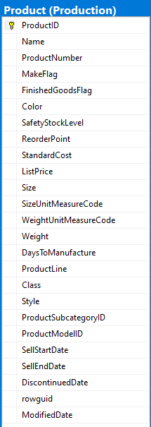
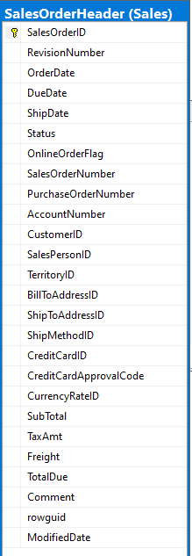
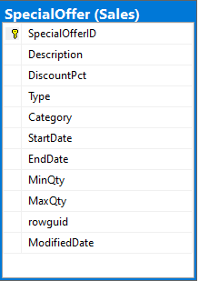
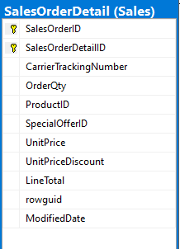
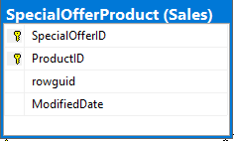

Slide 5
2. Defining the business objective
Is income/profitability seasonal?
Is there an upward or downward trend in company data over months and years?
What is the impact of discounts on company profit?

Slide 6
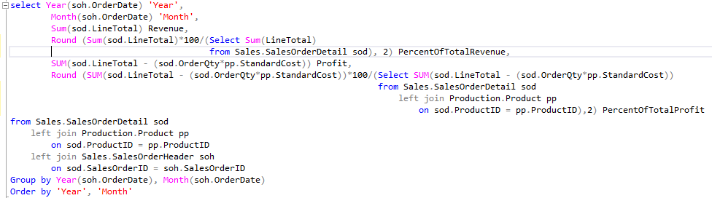
03. Research
1. Is income/profitability seasonal?
To find the total income and profit for each month, we applied the code sequence below.
The results show total revenue and profit divided by each month of the year.
To these we added the percentage divided by each month of the respective total calculated over all years.

Slide 7
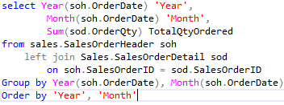
Goals for Q1
2. Is there an upward or downward trend in company data over the months and years?
End of fiscal celebration on July 15th
Employee day of learning on August 14th
Employee yoga on September 3rd
Seminar series begins September 10th
Using the same sequence of code as in the previous slide, we can detect the trend of the revised data.
The code opposite can also be used to get a more detailed understanding of the quantity of products ordered each month of the year.Maintain growth
Diversify investment in sector 2
Initiative partnership with 3rd party organizations

Slide 8
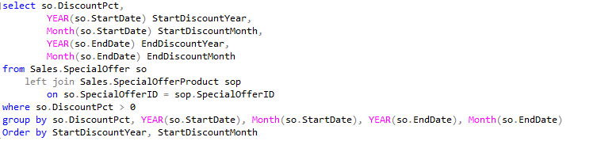
Goals for Q2
3.What is the impact of the discounts on company profits?
In order to identify the discounts applied to the products, we have applied the code below, grouping the data by months and years.

Slide 9
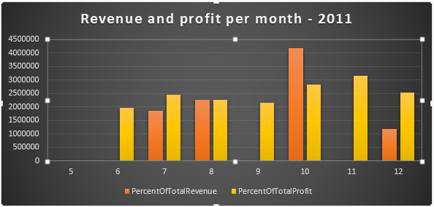
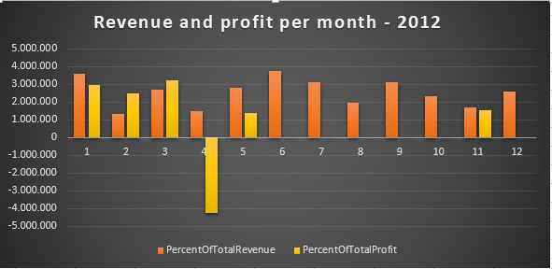
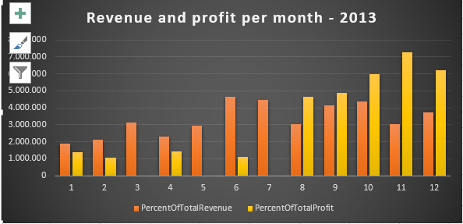
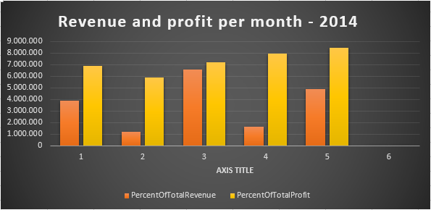
3. Results
Is income/profitability seasonal?
Profits are up in the last quarter by 3%
We increased customer retention by 4%
Looking at the tables, we can identify an increase in profit in the first and last quarter of almost every year.
In terms of revenue, it fluctuates and has not shown a constant.
We are top leaders in the industry
across the board
Last year we supported thousands of customers and
sold 60,000 units

Slide 10
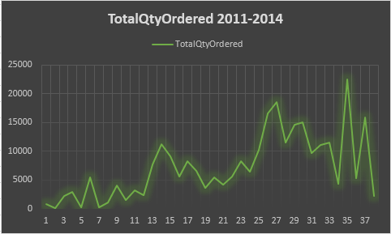
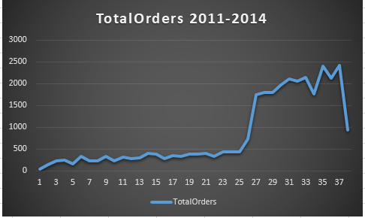
Is there an upward or downward trend in company data over the months and years?
From 2011 to 2014 we see major increases in the number of orders and products ordered.
At the same time, the data end with a fall last month.

Slide 11
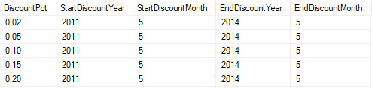
What is the impact of discounts on company profits?
Multiple discounts were available throughout the valid dates.
We can see at the end of the promotions a drastic drop in both revenue and profit.

Slide 12

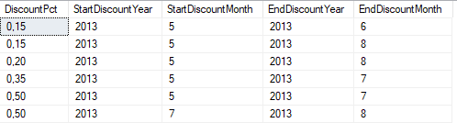
What is the impact of discounts on company profits?
With the exception of the 2014 rebates, the other rebate periods represented a decrease in the amount of profit.

Slide 13
Conclusions
Revenues do not seem to follow a pattern, but we can see that profits increase especially in the first and last quarters of the years (excluding the last months of 2012 and the first months of 2013).
Except for the 6th month of 2014, we can observe an almost constant upward trend in data.
The discounts seem, for the most part, to help boost revenues and profits.

Slide 14
Recommendations
Continuity of discounts/promotions;
Market research;
Detailed analysis of the reasons for income fluctuations and profit inconsistencies.

Slide 15

Thank you

